Slide 1
CSS

Slide 2
CSS Background: (contd…)
This property specifies the background color of an element.
<style>
body
{
background-color: #b0c4de;
}
</style>
Webpage bg_color
With CSS, a color is most often specified by:
  a HEX value - like "#ff0000"
  an RGB value - like "rgb(255,0,0)"
  a color name - like "red"

Slide 3
CSS Background Image:
This property specifies an image to use as the background of an element.
By default, the image is repeated so it covers the entire element.
body
{
background-image: url(“demo.jpg");
}
  Bg_image example

Slide 4
CSS Background Image:
This property specifies an image to use as the background of an element.
By default, the image is repeated so it covers the entire element.
body
{
background-image: url(“demo.jpg");
}
  Bg_image example

Slide 5
CSS Background Image: (contd…)
Background Image - Repeat Horizontally or Vertically
By default, the background image property repeats an image both horizontally and vertically.
body
{
background-image: url("gradient_bg.png");
background-repeat: repeat-x;
}
Bg_image horizontal repeat
Bg_image vertical repeat

Slide 6
CSS Background Image: (contd…)
Background Image - Set position and no-repeat
Showing the image only once is specified by this property.
Bg_image no repeat & bad formatting
Bg_image no repeat & good formatting

Slide 7
CSS Background Image: (contd…)
Background Image - Shorthand property
As you can see from the examples above, there are many properties to consider when dealing with backgrounds.
To shorten the code, it is also possible to specify all the properties in one single property. This is called a shorthand property.
body
{
background: #ffffff url("img_tree.png") no-repeat right top;
}
Bg_shorthand example

Slide 8
CSS Background Image: (contd…)
Background Image - Shorthand property
When using the shorthand property the order of the property values is:
  background-color
  background-image
  background-repeat
  background-attachment
  background-position
It does not matter if one of the property values is missing, as long as the ones that are present are in this order

Slide 9
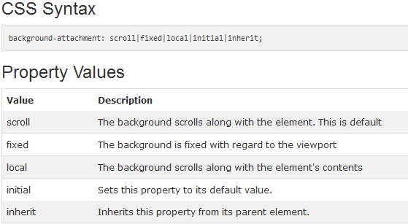
CSS Background Image: (contd…)
Background-attachment property
Sets whether a background image is fixed or scrolls with the rest of the page. Example1 and 2
Task: Give examples for each of the property values mentioned in above table in one html page.

Slide 10
CSS Background Image: (contd…)
background-position Property
The background-position property sets the starting position of a background image.
Tip: By default, a background-image is placed at the top-left corner of an element, and repeated both vertically and horizontally.
Example

Slide 11
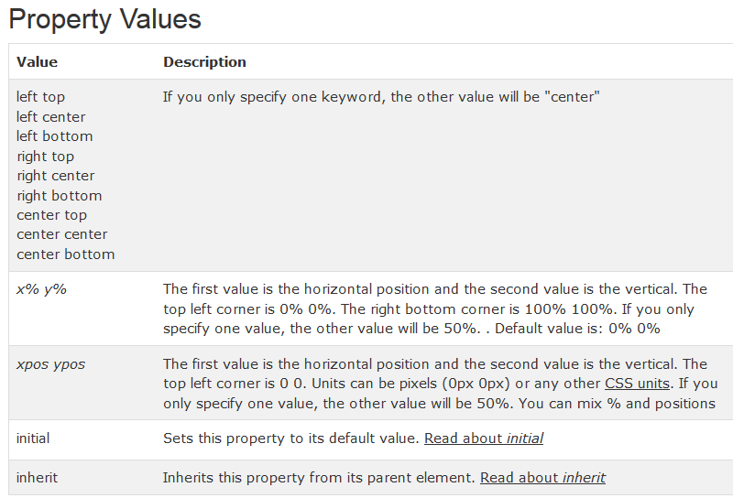
CSS Background Image: (contd…)
background-position Property
The background-position property sets the starting position of a

Slide 12
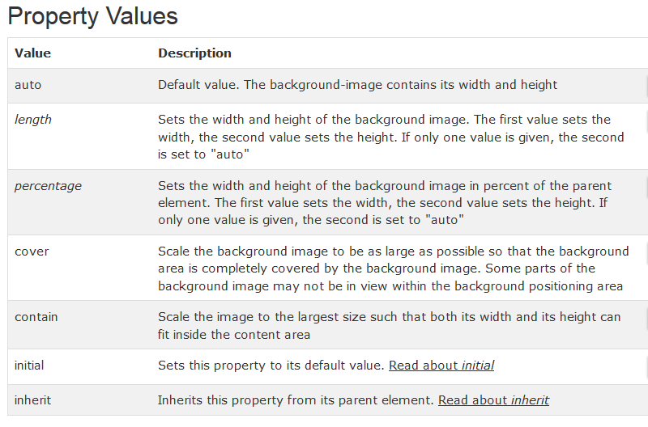
CSS Background Image: (contd…)
background-size Property
Example

Slide 13
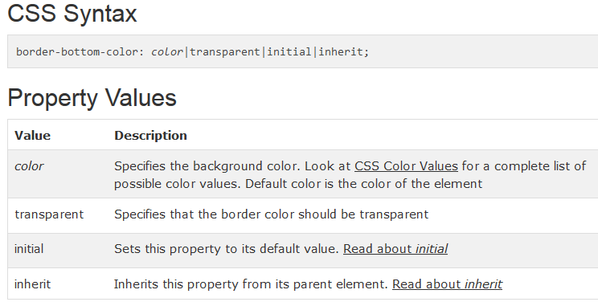
CSS Border Properties: (contd…)
border-bottom-color Property
The border-bottom-color property sets the color of an element's bottom border.
Example

Slide 14
border-bottom-style Property
The border-bottom-style property sets the style of an element's bottom border.
Example

Slide 15
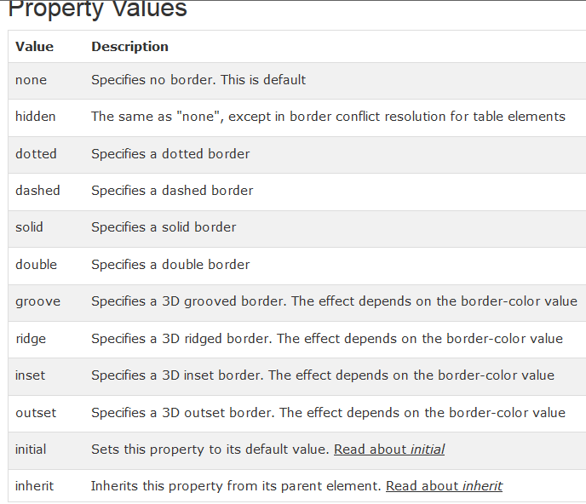

Slide 16
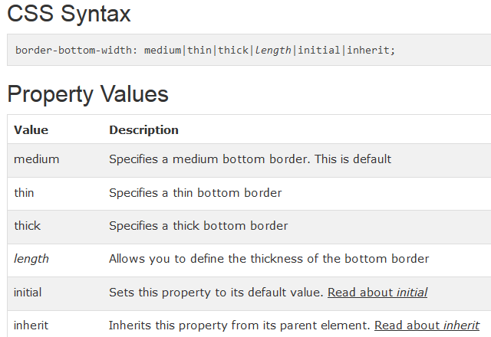
border-bottom-width Property
The border-bottom-width property sets the width of an element's bottom border.
Example

Slide 17
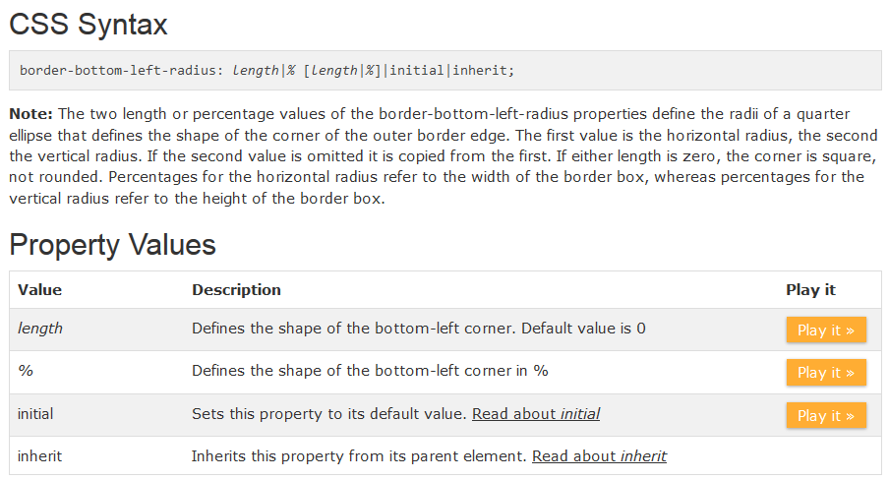
border-bottom-left-radius Property
The border-bottom-left-radius property defines the shape of the border of the bottom-left corner. Example

Slide 18
border-bottom-right-radius Property
The border-bottom-right-radius property defines the shape of the border of the bottom-right corner.
Example
Property values are same as border-bottom-left-radius property.

Slide 19
border-bottom Property
The border-bottom shorthand property sets all the bottom border properties in one declaration.
The properties that can be set, are (in order): border-bottom-width, border-bottom-style, and border-bottom-color.
It does not matter if one of the values above are missing, e.g. border-bottom: solid #ff0000; is allowed.

Slide 20
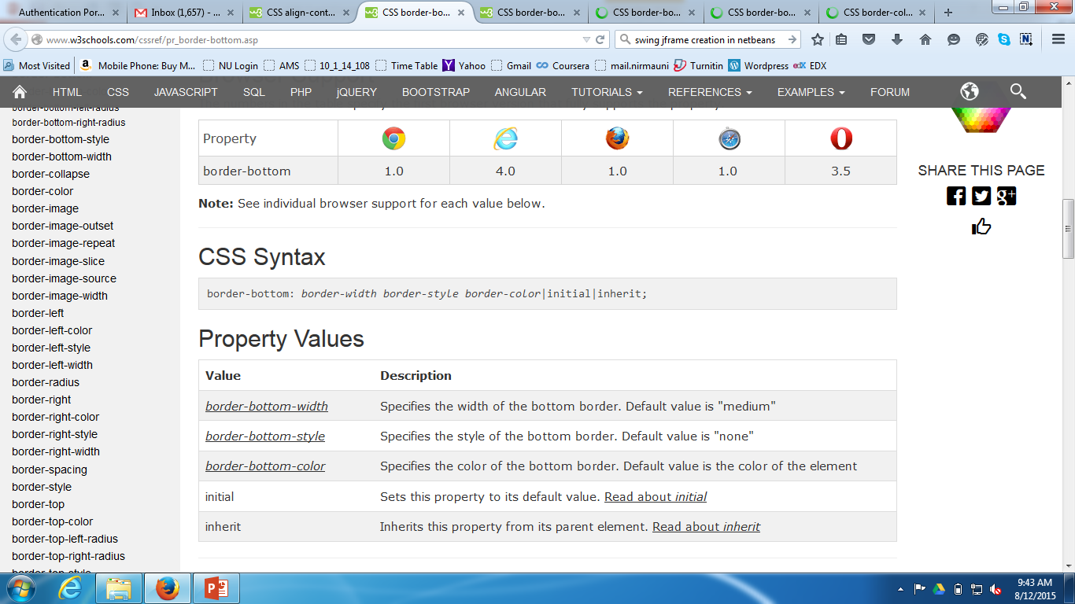
border-bottom Property

Slide 21
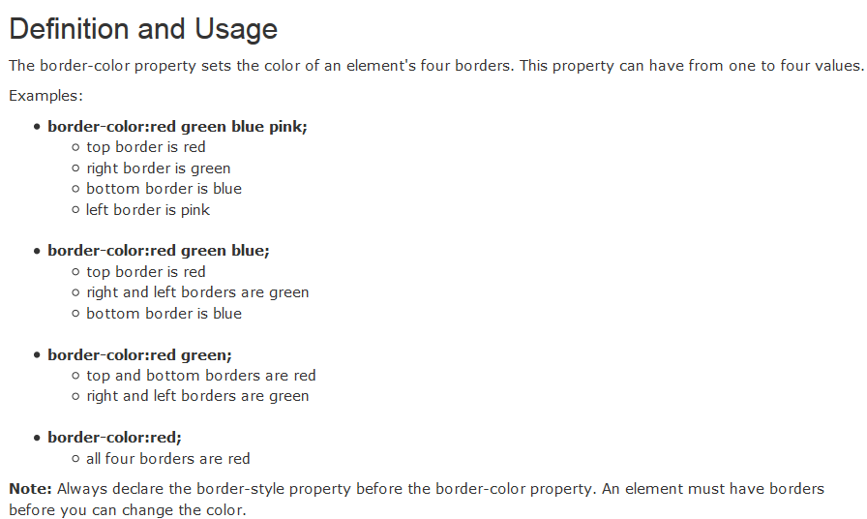
border-color Property

Slide 22
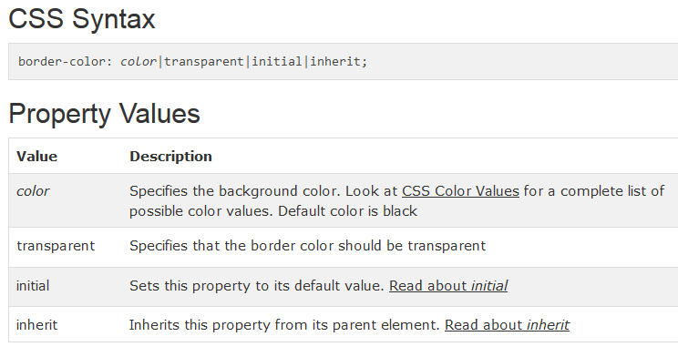
border-color Property
Example

Slide 23
Following properties are similar to border-bottom-* properties
  Border-left
  Border-left-color
  Border-left-style
  Border-left-width
  Border-right
  Border-right-color
  Border-right-style
  Border-right-width
  Border-top
  Border-top-color
  Border-top-style
  Border-top-width
  Border-top-left-radius
  Border-top-right-radius

Slide 24
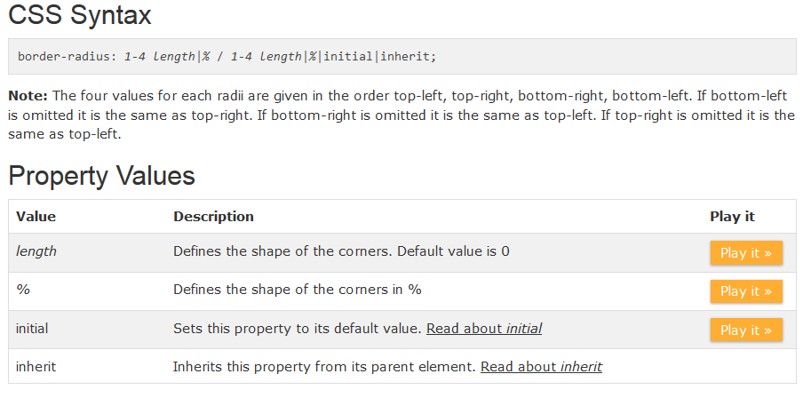
border-radius Property
The border-radius property is a shorthand property for setting the four border-*-radius properties.
Example

Slide 25
border-style Property
The border-style property sets the style of an element's four borders. This property can have from one to four values.
Example

Slide 26
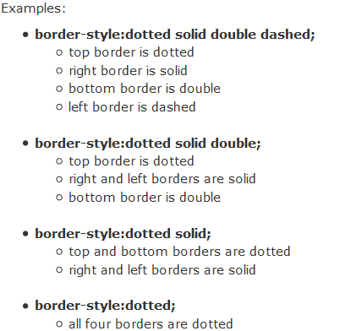
border-style Property

Slide 27
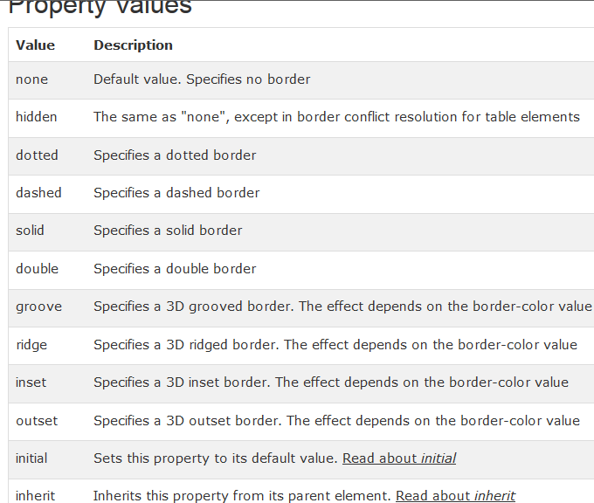
border-style Property

Slide 28
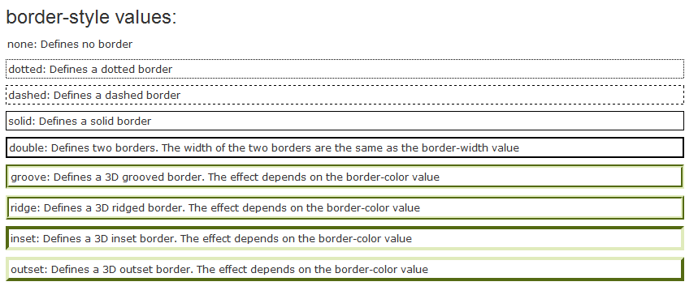
border-style Property

Slide 29
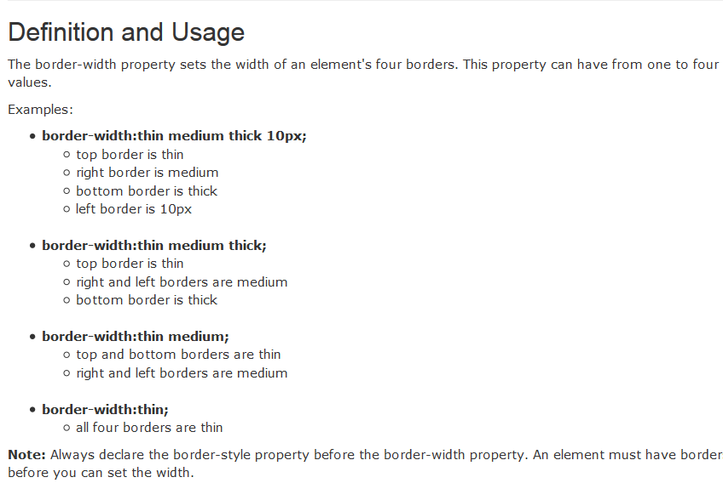
border-width Property
Example

Slide 30
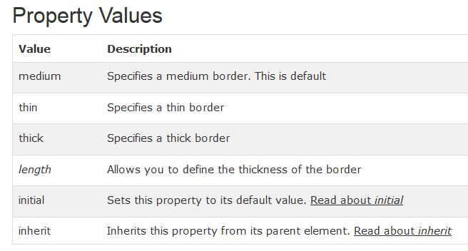
border-width Property
Example

Slide 31
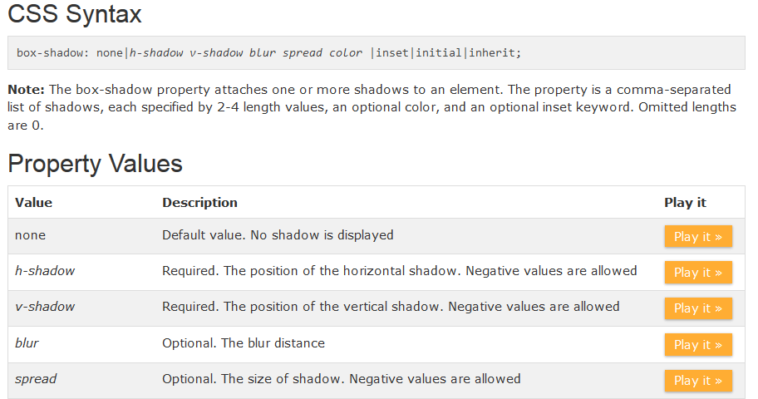
CSS box-shadow property:
The box-shadow property attaches one or more shadows to an element.
Example

Slide 32
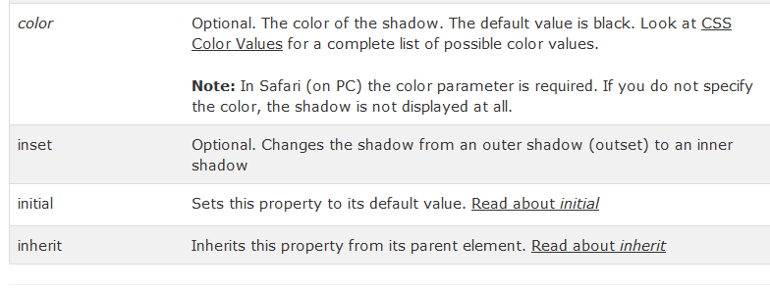
CSS box-shadow property:

Slide 33
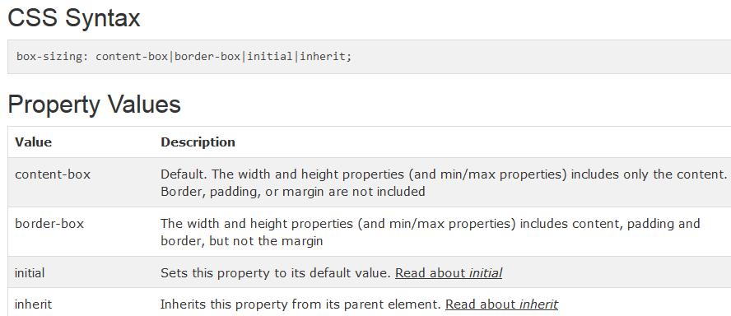
CSS box-sizing property:
The box-sizing property is used to tell the browser what the sizing properties (width and height) should include.
Should they include the border-box? Or just the content-box (which is the default value of the width and height properties)? Example

